Slide 1
Implementation of the RRT Algorithm
Scurtu Jasmin
Firtala Maria
Codarcea Alexandru

Slide 2
Content
Introduction
The Algorithm
Improvements
Interactive Menu

Slide 3
Introduction
The RRT (Rapidly-exploring Random Tree) algorithm is a path planning method used in robotics and artificial intelligence to find accessible routes in an obstacle-filled space.
RRT builds a random tree starting from the initial position, extending to randomly chosen points, with a constant distance. The goal is to connect the starting position with a target position, avoiding collisions with obstacles in the environment.Acesta este utilizat in aplicatii precum:
Video Games
Mobile robot navigation
Road planning for autonomous vehicles

Slide 4
The Algorithm - main steps
1. We initialize the tree: we create the start node, which we set as the root, and the target node
2. For each iteration:
Generate a random point on the map
We are looking for the closest node already existing in the tree to the randomly generated point
We extend the tree towards that point by a predefined distance
We add the node to the tree as a child of the nearest node
If the node is in the target region, it connects to the goal and stops searching.
3. We reconstruct the final path, walking the tree in reverse, from the goal to the start
4. We display the number of waypoints and the total distance of the route

Slide 5
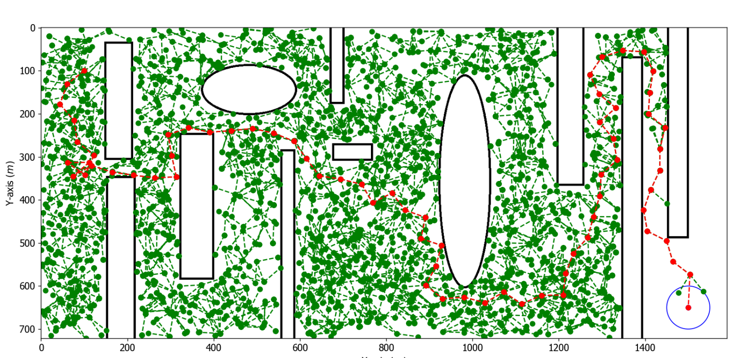
Classic implementation

Slide 6
Improvements made
Classic implementation
If on the route between the nearest node and a point oriented towards the random point, at a distance stepSize, there is an obstacle, the algorithm does not add any points and an iteration is lost.
The version implemented by us
In this case, the algorithm places a node at the edge of the obstacle, on the calculated trajectory, thus avoiding wasting an iteration and allowing the tree to expand continuously.

Slide 7
II. Improvements made
Context: When the distance between the random point and the nearest node is less than the preset distance (stepSize), the algorithm will still try to go exactly stepSize in that direction.
Classic implementation
If the movement with stepSize would lead the point off the map, the algorithm does not force exit and wastes an iteration.
The version implemented by us
In this case, it calculates the maximum possible position on the edge of the map, in that direction, and places the node there.Thus, the tree continues to expand continuously.

Slide 8
III. Improvements made
Classic implementation:
The random points are completely random, and the algorithm can "wander" through space too much.
To speed up the approach to the target, we introduced a strategy:
Once every 10 iterations, the randomly generated point has :
coordinate y of the target (goal) and a random x, or coordinate x of the target and a random y
The purpose of this technique:
Increases the chance that the tree will head towards the target area
Reduces the number of useless steps i in other directions
Helps the algorithm to find a way faster

Slide 9
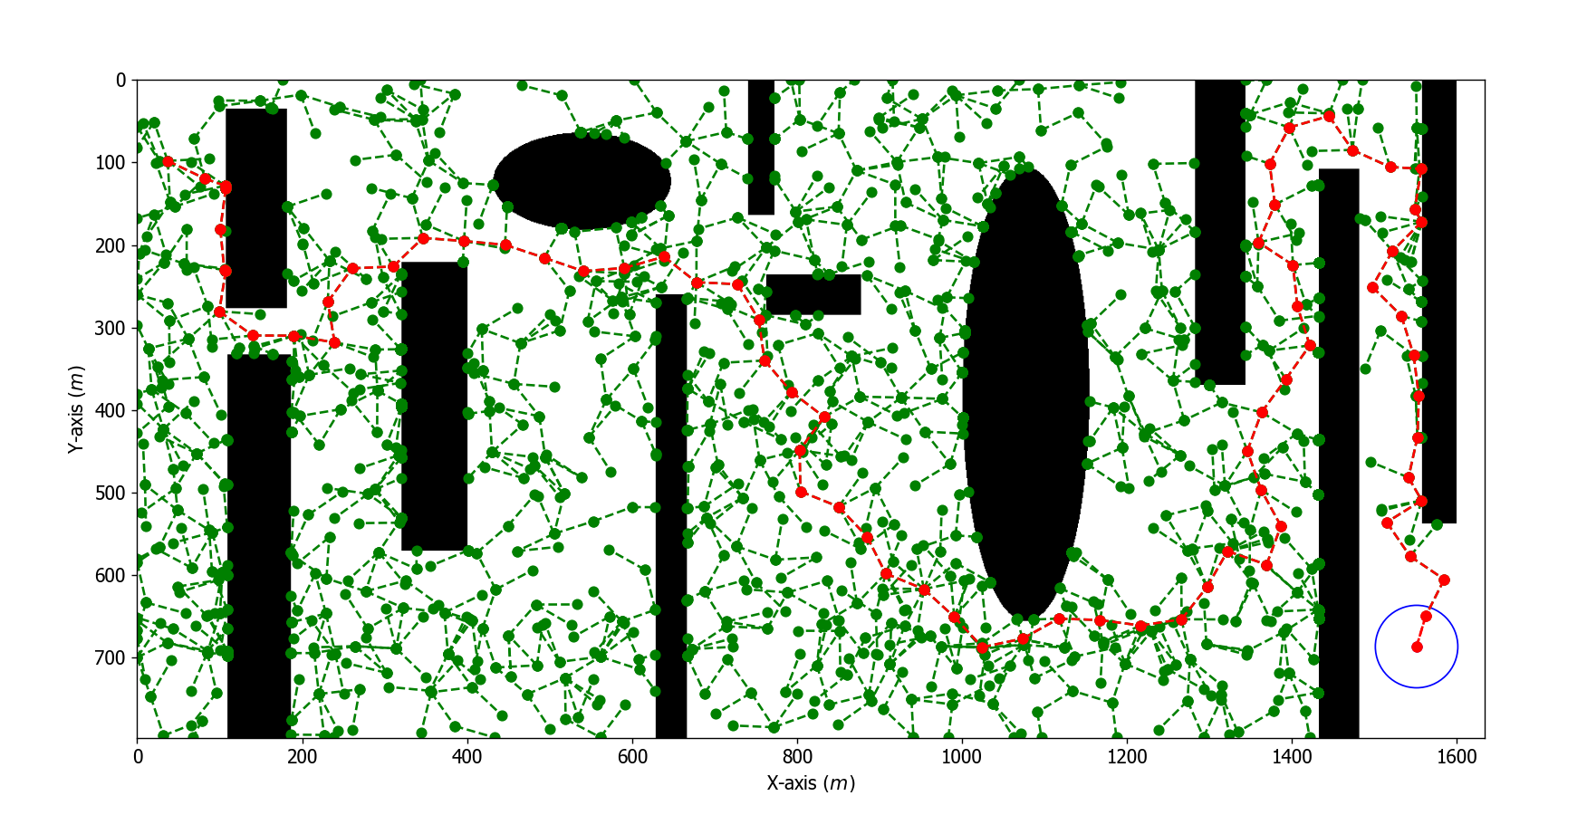
The version implemented by us

Slide 10
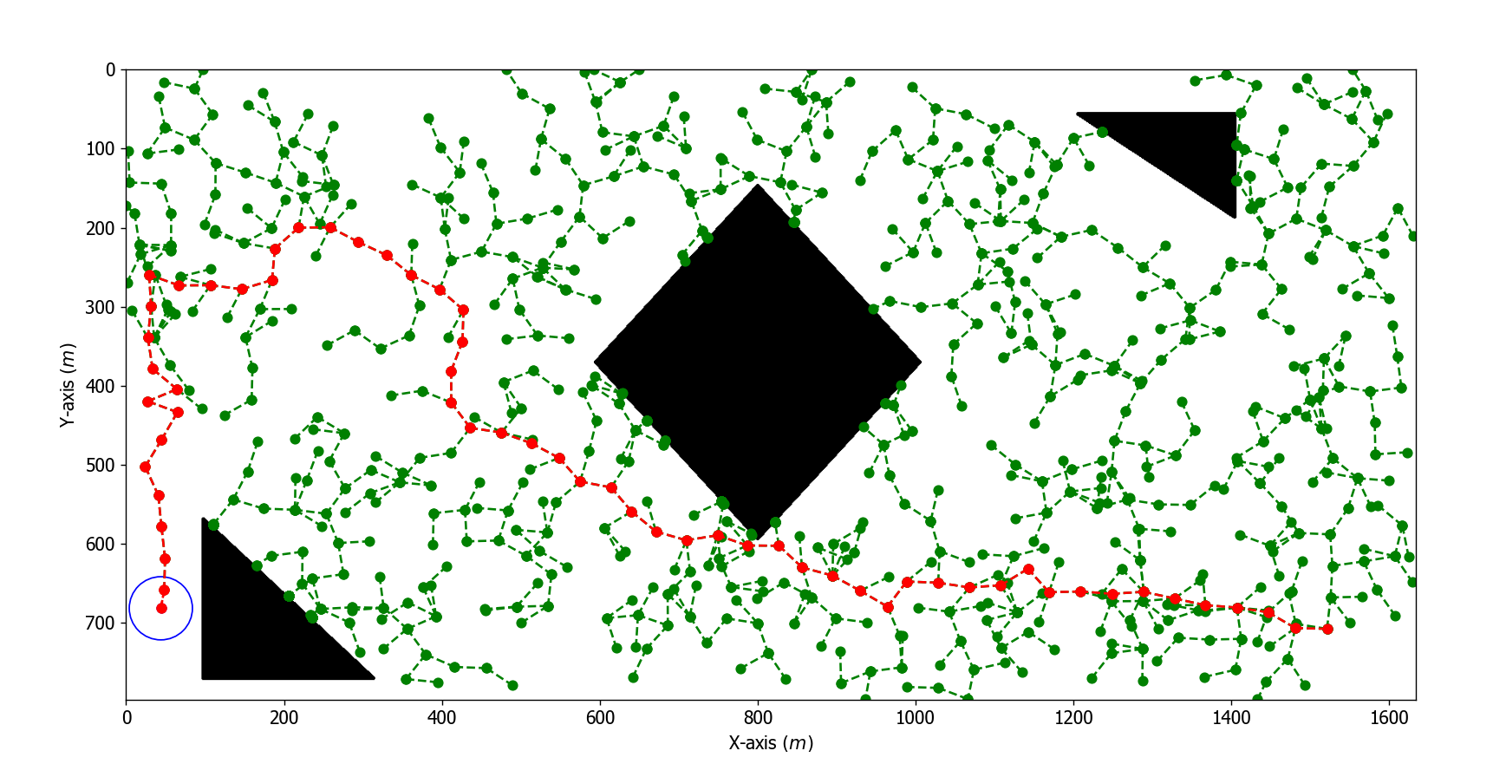

Slide 11
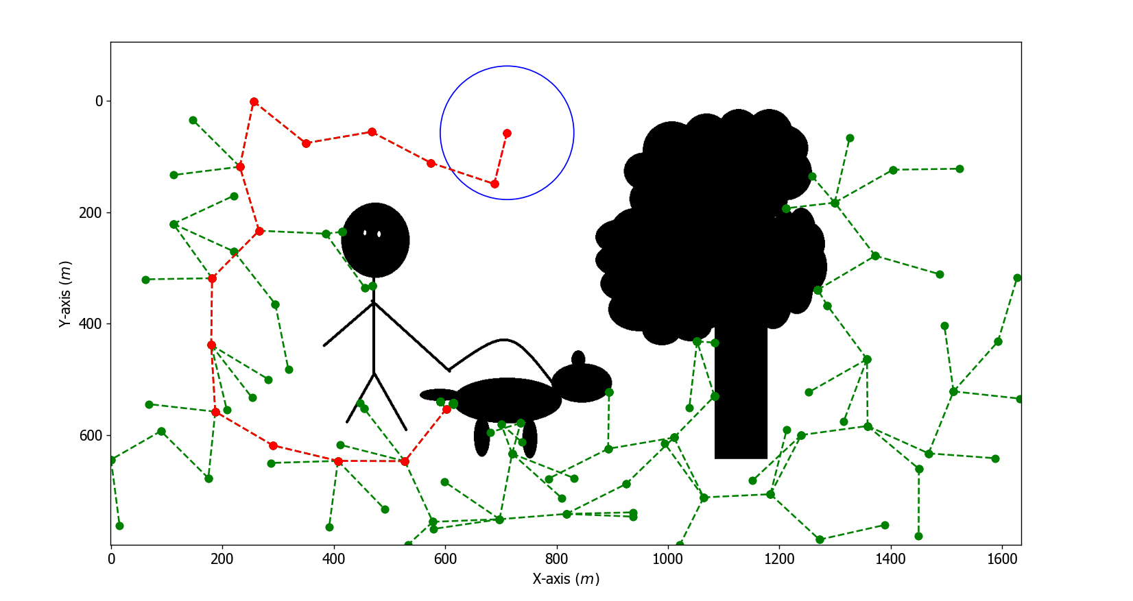

Slide 12
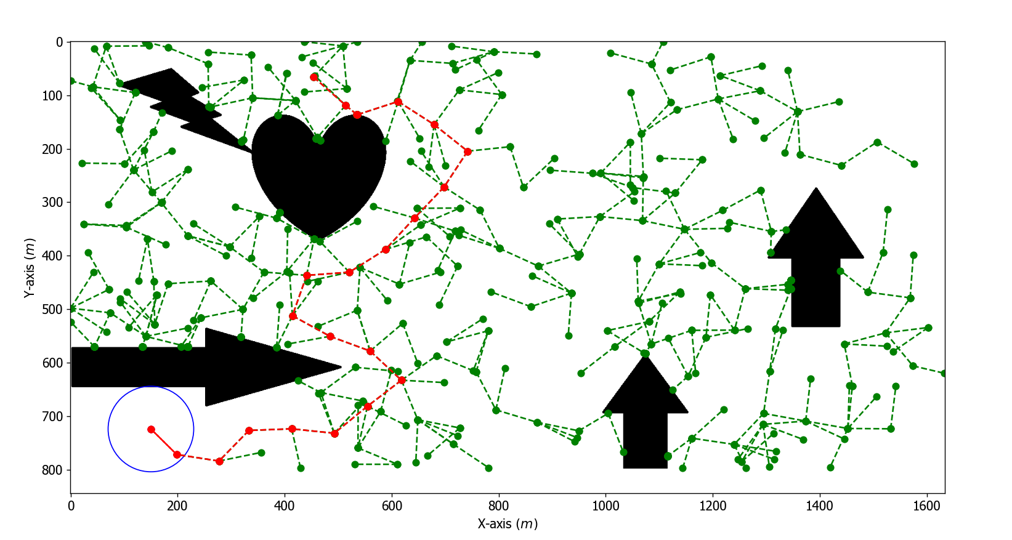

Slide 13
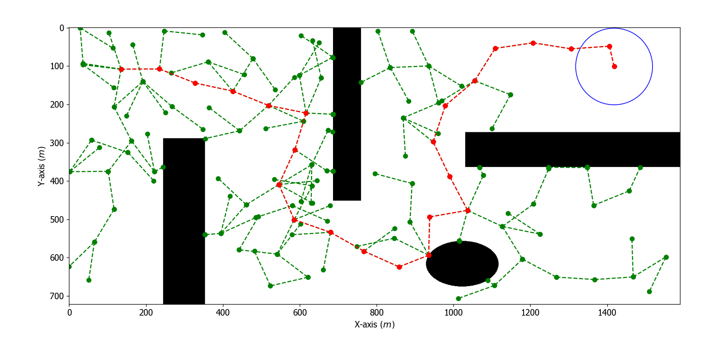

Slide 14
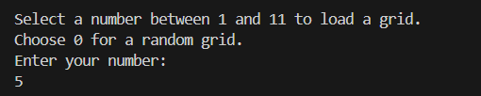
Interactive Menu
We added a user friendly menu through which we can select a different grid to test the performance of the algorithm.

Slide 15
Thank you for your attention!

